Slide 1
Solar Car Suspension
Jarrett Dunn
SOLAR CAR CHALLENGE

Slide 2
Agenda
Introduction
Suspension Types
Key Terms
Measuring Toe
Ackerman Steering
Best Practices

Slide 3
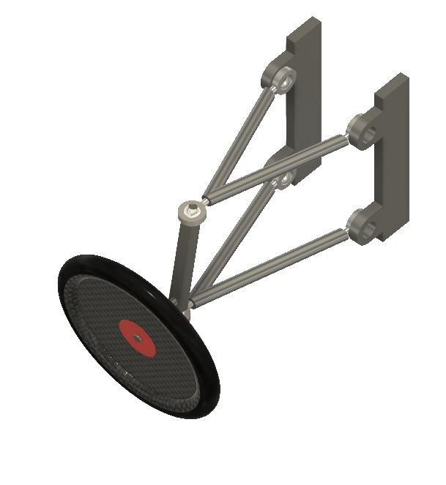
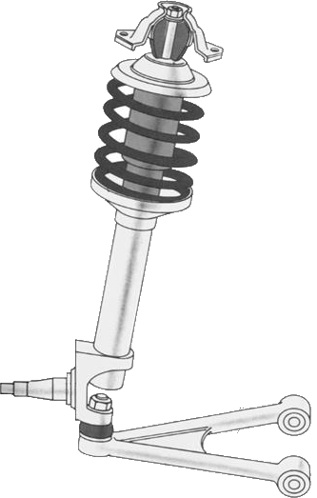

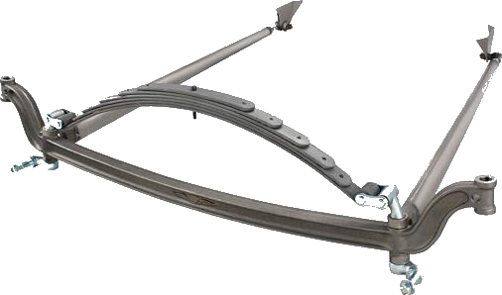
Common Front Suspension Types
MacPherson Strut
Solid Axle
Dual A Arm
Notes:
MacPherson
-tend to be heavy
-limited adjustability
Solid Axles
-simple
-geometry is set at construction
-can be heavy
Double Arm
-most popular
-very versatile
-can be complicated with lots of options and area for mistakes

Slide 4
Less Common Suspension Types
Torsion Axle
Radius Arm
Mountain Bike Fork
Solid

Slide 5
Vocabulary
Contact Patch
  Oval shaped area where tire contacts the road
Steering Axis
  Line between two pivot points of the wheel
Side
Top
Side
Top
Ideal
Real

Slide 6
Contact Patch
This is where your car interacts with the road
Critical to cars steering, handling, and braking
Effected by tire type, construction, pressure

Slide 7
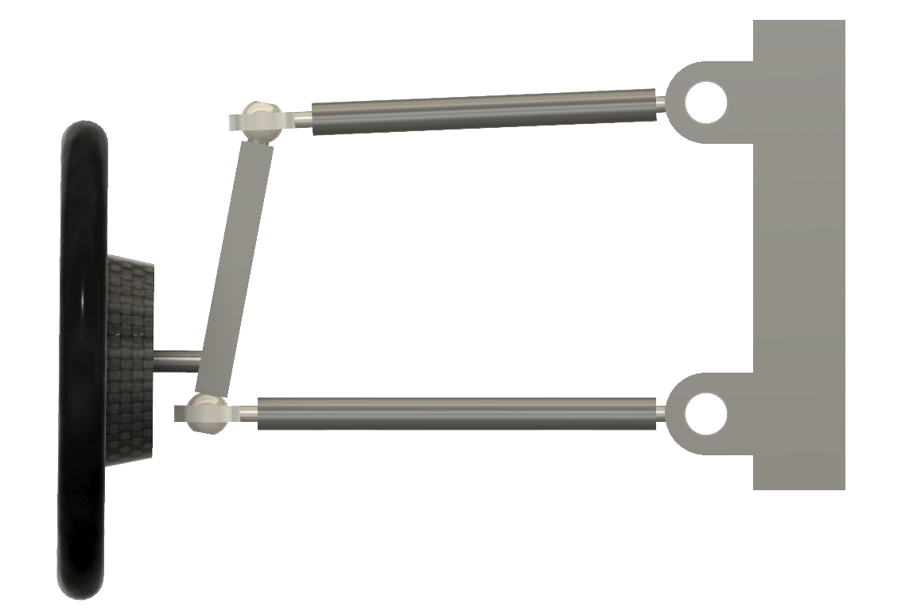
Vocabulary
Contact Patch
  Oval shaped area where tire contacts the road
Steering Axis
  Line between two pivot points of the wheel

Slide 8
Vocabulary
Toe
  Angle of the wheel and tire pointing away from the centerline of the vehicle
Caster
  The angular displacement of the steering angle for the vertical axis
Camber
  The angle of the wheel and tire with respect to the vertical axis
Scrub Radius
  The distance between where the steering angle intersects the ground and the contact patch of the tire

Slide 9
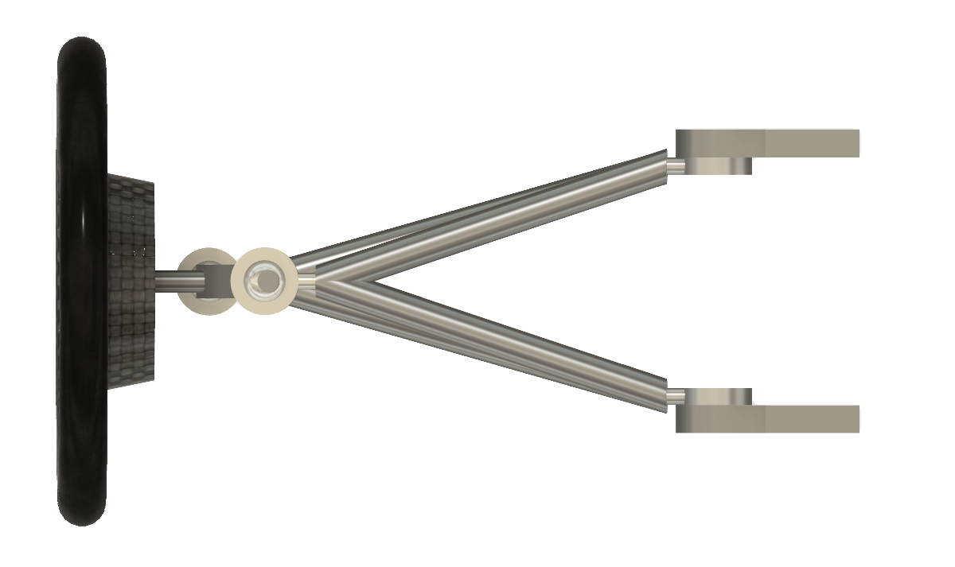
Toe (Neutral)
Front
Center Line

Slide 10
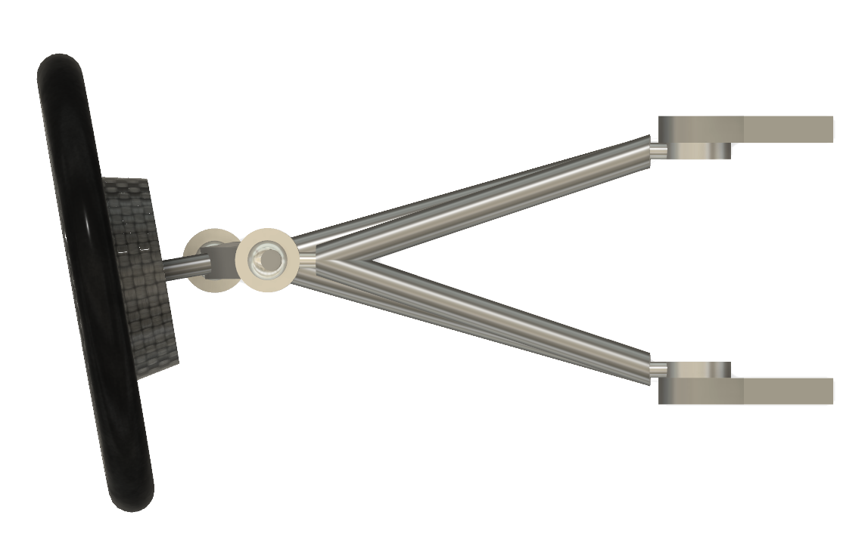

Toe (In)
Center Line
$$∅$$
Front

Slide 11
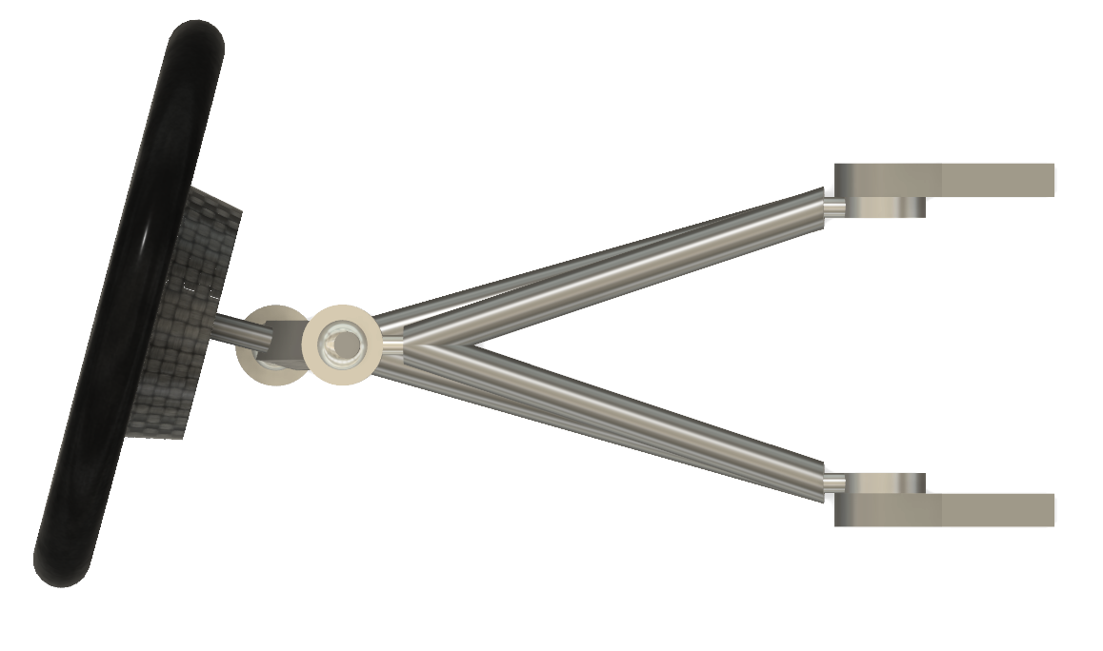

Toe (Out)
Center Line
$$∅$$
Front

Slide 12
Toe
Affects Tire Wear
Toe Out
  Improves Steering Response
  Can make steering “jerky”
Toe In
  Improves straight line stability

Slide 13
Vocabulary
Toe
  Angle of the wheel and tire pointing away from the centerline of the vehicle
Caster
  The angular displacement of the steering angle for the vertical axis
Camber
  The angle of the wheel and tire with respect to the vertical axis
Scrub Radius
  The distance between where the steering angle intersects the ground and the contact patch of the tire

Slide 14
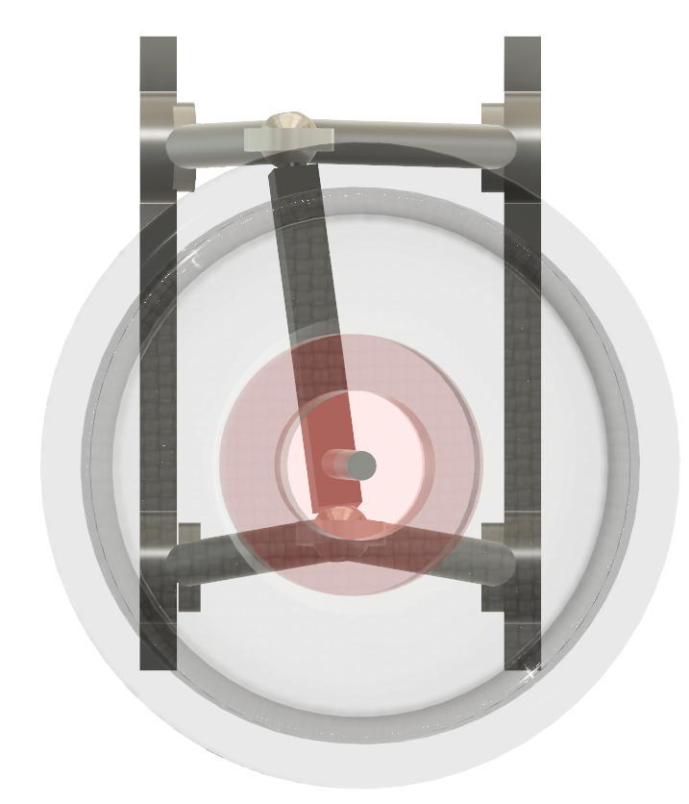
Caster (Positive)
Vertical
θ
Front

Slide 15
Caster
Creates straight line stability
Positive Caster
  Steering wheel feedback
  Makes car harder to turn
  Causes wheels to self center
Negative Caster
  Unstable

Slide 16
Vocabulary
Toe
  Angle of the wheel and tire pointing away from the centerline of the vehicle
Caster
  The angular displacement of the steering angle for the vertical axis
Camber
  The angle of the wheel and tire with respect to the vertical axis
Scrub Radius
  The distance between where the steering angle intersects the ground and the contact patch of the tire

Slide 17
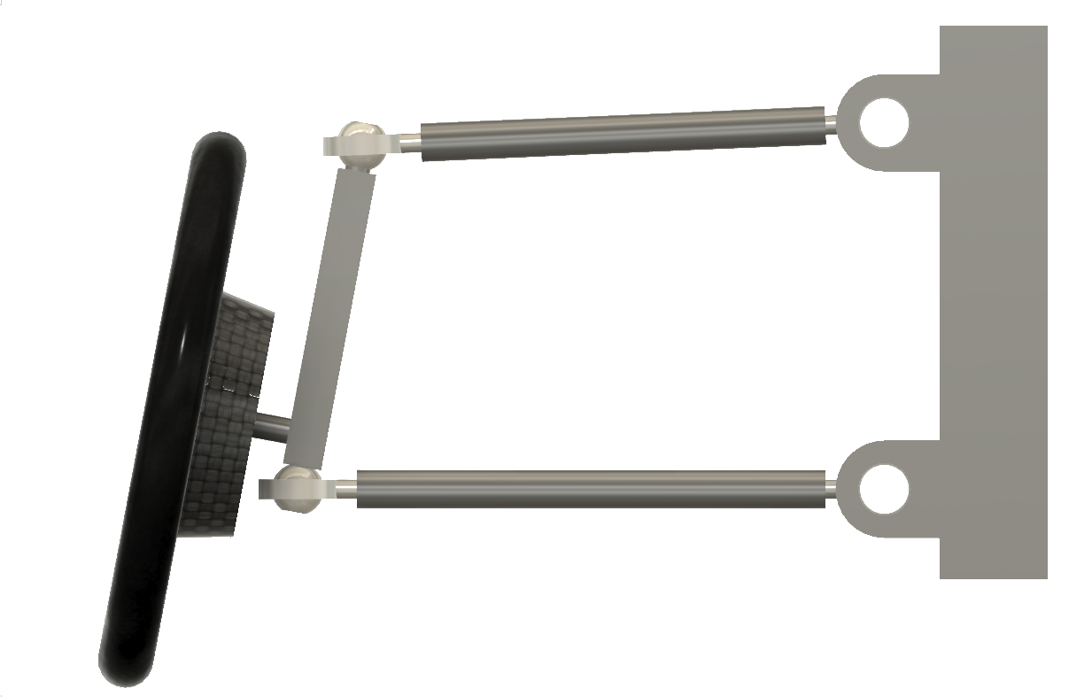

Camber (Negative)
Vertical
$$∅$$
Front

Slide 18
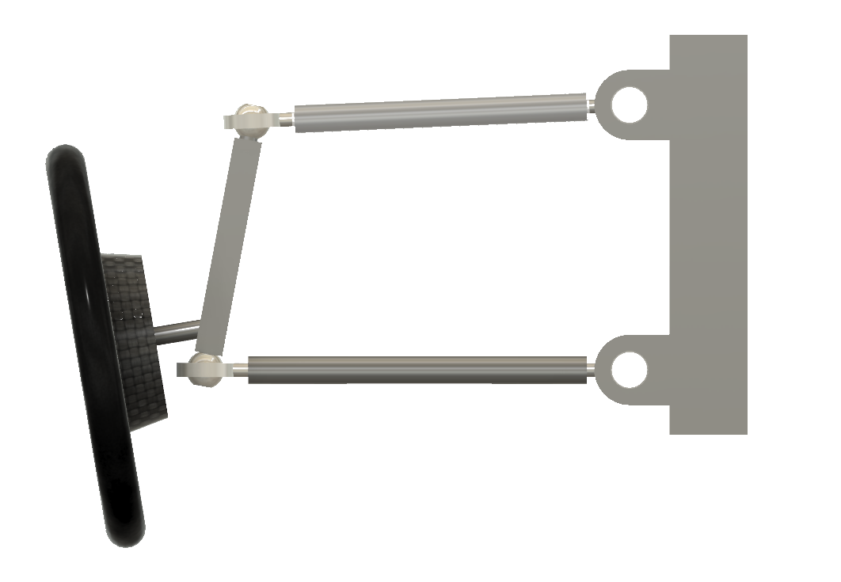

Camber (Negative)
Vertical
$$∅$$
Front

Slide 19
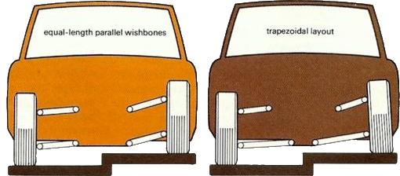
Camber
Affects grip and stability in cornering
Not applicable to solar car racing
Camber Gain

Slide 20
Vocabulary
Toe
  Angle of the wheel and tire pointing away from the centerline of the vehicle
Caster
  The angular displacement of the steering angle for the vertical axis
Camber
  The angle of the wheel and tire with respect to the vertical axis
Scrub Radius
  The distance between where the steering angle intersects the ground and the contact patch of the tire

Slide 21
Scrub Radius (Positive)
Scrub Radius

Slide 22
Scrub Radius
Coffee Cup Experiment
Harder to Turn
Increase wear on tire
Positive
  Cause center seeking

Slide 23
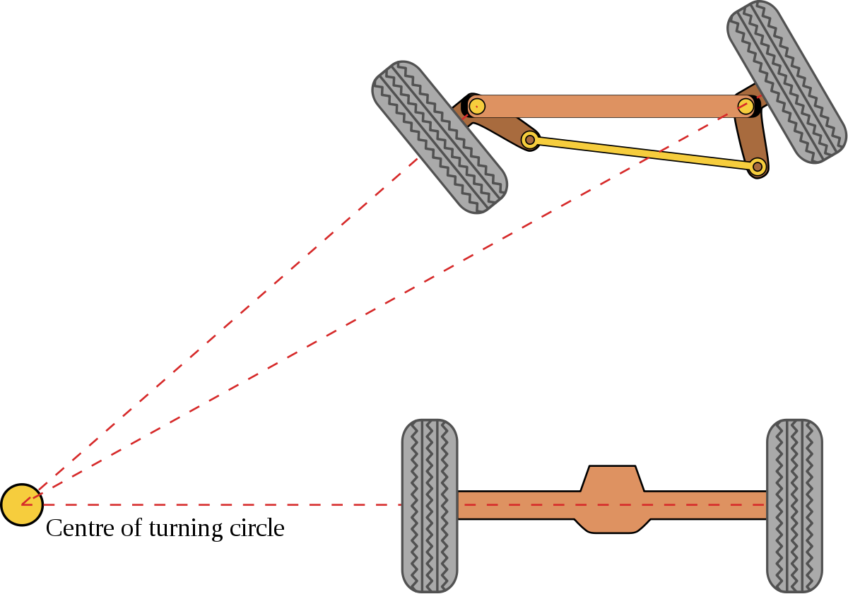
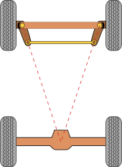
Ackerman Steering

Slide 24
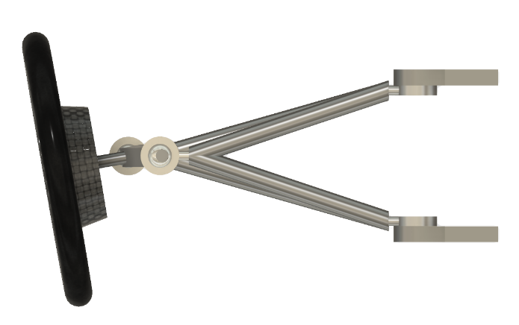
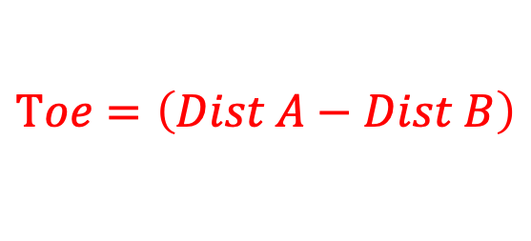
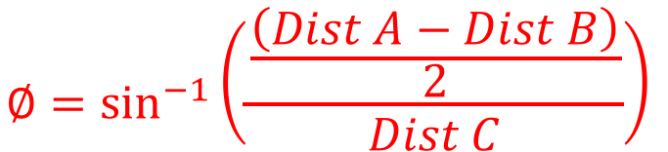
Measuring Toe
Front
$$∅=\sin^{−1}\left(\frac{\frac{\left(Dist A−Dist B\right)}{2}}{Dist C}\right)$$
Dist A
A2
A1
$$Toe=\left(Dist A−Dist B\right)$$
Dist B
C
B1
B2

Slide 25
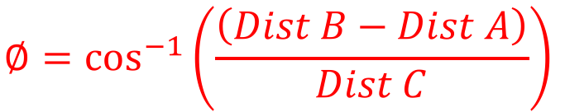
Measuring Toe
A1
A2
Front
C
B1
B2
$$∅=\cos^{−1}\left(\frac{\left(Dist B−Dist A\right)}{Dist C}\right)$$

Slide 26
Best Practices
Consistency is key
  Be methodical
  Do the same thing every time
Make Dedicated Tools
Solar car racing is about efficiency
  Small or zero angles
Date | Tire Pressure | Driver | Toe

Slide 27
References
Tune to Win, Carrol Smith
Design to Win, Carrol Smith
The Winning Solar Car, Douglas R. Carroll
The Leading Edge, Goro Tamai

